Slide 1
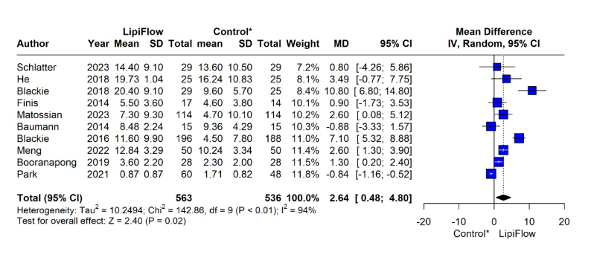
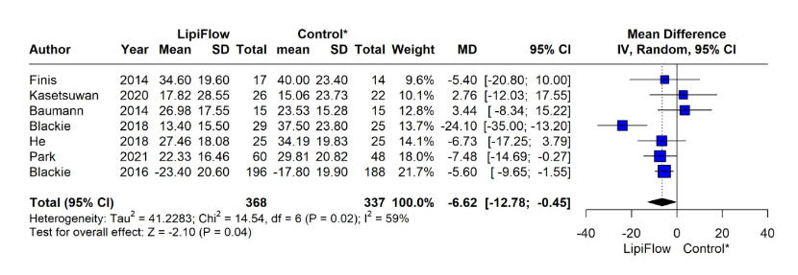
Efficacy of Lipiflow in the treatment of dry eye due to meibomian gland dysfunction: a systematic review with meta-analysis.
João Lucas Moreira¹, Larissa Barbosa², Sara Hira³,Vanio Antunes⁴, Mateus Arruda⁵, Giulia Steuernagel Del Valle⁶. 1- Universidade Estadual de Feira de Santana, Feira de Santana, Bahia, Brazil; 2- Faculdade Santa Marcelina, São Paulo, São Paulo, Brazil; 3- FMH College of Medicine & Dentistry, Lahore, Punjab, Pakistan; 4- Universidade Federal de Ciências da Saúde de Porto Alegre, Porto Alegre, Rio Grande do Sul; 5- Instituto Penido Burnier, Campinas, São Paulo, Brazil – Department of Retina; 6- University of Iowa, Iowa City, Iowa, USA.
INTRODUCTION
Meibomian gland dysfunction (MGD) is the main cause of dry eye disease (DED) worldwide.¹ Standard treatment is mainly based on lubricating eye drops and eyelid hygiene with warm compresses., LipiFlow thermal pulse system has been proposed as an alternative. This updated systematic review and meta-analysis aims to evaluate it in the treatment of meibomian gland dysfunction.
INTRODUCTION
METHODS
We systematically searched EMBASE, MEDLINE, Cochrane, and Web of Science databases up to December 2022 for randomized clinical trials (RCTs) evaluating patients with meibomian gland dysfunction treated with LipiFlow. Main outcomes of interest were the meibomian gland scale (MGS), ocular surface disease scale (OSDI), Standard Patient Evaluation of Eye Dryness Questionnaire (SPEED) and Tear Break-up time (TBUT). We performed leave-one-out sensitivity analyses and subgroup analyses involving patients undergoing cataract surgery and studies with non-treatment as the control group. Statistical analyses were performed using RStudio 4.3.1 software using a random-effects model. Heterogeneity was assessed with I² statistics.
RESULTS
We included 12 RCTs comprising 1,045 patients. Among them, 538 (51.5%) were treated with LipiFlow. An improvement was observed in the MGS at 3 months (MD 2.64 95%CI [0.48; 4.80]; p=0.04; I2=94%; Fig. 1), in the OSDI at 3 months (MD -6.62 95%CI [-12.78; -0.45]; p=0.02; I2=59%; Fig. 2), as well as in the TBUT at 1 month (SMD 0.21 95%CI [0.01; 0.40]; p=0.04; I2=19%; Fig 3). There was no statistical significance in the SPEED at 3 months (MD -2.24 95%CI [-4.85; 0.37] p=0.09; I2=83%; Fig. 4), TBUT at 3 months (MD 0.10 95% CI [-2.04; 2.33] p=0.93 I² = 79%), OSDI at 1 month (MD -2.86 95% CI [-7.24; 1.52] p=0.20 I² = 0%), and MGS at 1 month (MD 0.10 95%CI [-0.60; 0.40] p=0.69 I² = 55%).
RESULTS
CONCLUSION
This systematic review and meta-analysis explores the effectiveness of Lipiflow compared to control in treating MGD. While the findings revealed statistically significant improvements in MGS, OSDI and TBUT at various time points, some comparisons did not yield significant results. Specifically, no statistical significance was observed for MGS and OSDI at 1 month, for SPEED at 3 months, and for TBUT at 3 months. These non-significant findings highlight the complex and variable nature of DED treatment responses and the importance of considering multiple parameters and timeframes in assessing therapeutic efficacy. Despite these nuances, the significant improvement in objective measures such as MGS and TBUT, with the significant reduction in OSDI scores, suggests a favorable effect of LipiFlow treatment on DED symptoms and ocular surface health. It is important to note the challenges associated with the heterogeneity observed in some outcomes, requiring cautious interpretation and emphasizing the need for further research with larger and more homogenous sample sizes and standardized methodologies. Moreover, the non-significance observed in SPEED reinforces the importance of exploring subjective symptomatology in conjunction with objective clinical measures to comprehensively assess treatment efficacy. Overall, the current evidence suggests that LipiFlow can be a beneficial treatment option for DED, but ongoing research is crucial for refining treatment guidelines and optimizing patient outcomes.
Figure 1. MGS at 3 months
Figure 2. OSDI at 3 months
Figure 3. TBUT at 1 month
SUPPLEMENTARY FOREST PLOTS
REFERENCES
Figure 4. SPEED at 3 months

