Slide 1
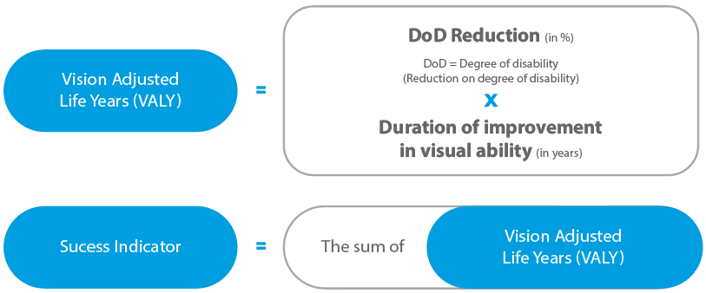
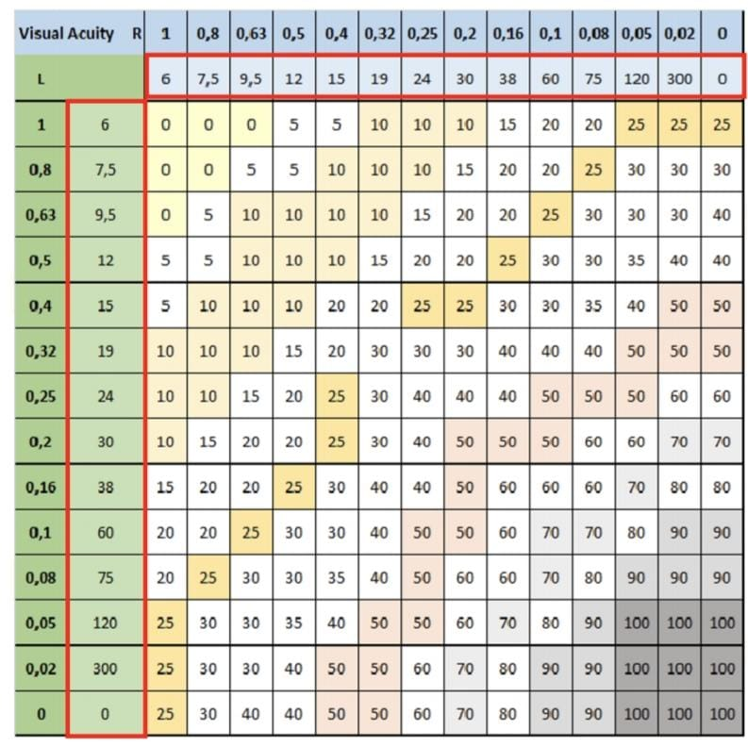
VALY (Visual Adjusted Life Years): Is it an efficient way to measure social impact based on visual interventions?
Gil Ferreira, Bruna ¹ ²; Akahoshi do Nascimento, Cristina¹; Galvão Viana, Rodrigo¹;
Ferreira de Lima, Julia¹; Freiherr von Künßberg, René²; Aufmuth, Martin².
Associação de Apoio Renovatio¹
Good Vision International²
Purpose: Many non-profit eyecare providers claim that visual interventions can positively impact social outcomes and therefore contribute to the social development goals of the United Nations. Although, there is no standard metric regarding the social impact that follows from these interventions. We created a formula to evaluate how these outcomes on visual improvement can be measured and compared: VALY (Visual Adjusted Life Years).
Methods: This research involves creating an experimental model to develop a mathematical framework to quantify visual improvement. The VALY calculation is based on three factors: the initial degree of visual impairment, the improvement of vision after the correction, and the expected duration of the intervention. The sum of the VALY (Succes Indicator) shows the social impact produced. (Figure 1).
(Figure 1): Formula for calculating the VALY (Vision Adjusted Life Years).
Results:
The result of the study is the calculation model itself: specific for each pathology, taking into consideration the particularities and the duration of the intervention. The reduction of the degree of disability (DoD) is determined by a table that considers the initial and final visual acuity (VA) of each eye (Figure 2), multiplied by the duration of intervention (in years). Not every intervention has the same weight in the calculation, depending on the level of visual impairment of the individual. A higher VALY corresponds to a higher visual rehabilitation.
(Figure 2): Degree of disability is calculated based on the visual acuity of each eye.
Conclusions:
The cumulative VALY serves as a crucial and easily reproducible measurement tool, facilitating the evaluation of the effectiveness of visual interventions.
References:
Palani, A.; Panigrahi, M.; Purohit, A. K. Tuberculum sellae meningiomas: A series of 41 cases; surgical and ophthalmological outcomes with proposal of a new prognostic scoring system. Vol 3. Journal of Neurosciences in Rural Practice | September - December 2012

