Slide 1
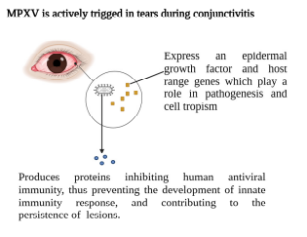
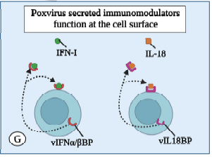
Monkeypox virus and ocular surface interactions: the glycosaminoglycans as host receptors
Cruz, SFS¹; Lucena-Neto, FD²; Cruz, MFS³; Vieira-Junior, AS²;
Falcão, LFM^{2,4}; Quaresma, JAS^{2,4}.
1 - Irmandade Santa Casa de Misericórdia de São Paulo (ISCMSP); 2- Universidade do Estado do Pará (UEPA);
3 - Universidade Federal de São Paulo (UNIFESP) ); 3 - Universidade de São Paulo (USP-SP)
INTRODUTION
FIGURE
Eye lesions are a common manifestation during a monkeypox virus (MPXV) infection. The eyelids may be severely affected, sometimes unable to open for a few days, due to a generalized pustular rash and secretions. Orthopoxviruses can evade host immune responses by secreting proteins that antagonize the functions of host IFNγ, CC and CXC chemokines, IL-1β and the complement system. The infection has a prodromal stage followed by a characteristic eruption that evolve from macules to papules, pustules, or vesicles, progressing similarly to smallpox infection.
MATERIAL E METHODS
It was conducted a semi-systematic narrative review. The primary databases was from PubMed, ScienceDirect and Cochrane. The search terms, used both separately and in combination, included: “MPXV eye disease”, “MPXV ocular manifestation”, “MPXV pathophysiology”.
CONCLUSION
The double-stranded DNA of the poxvirus produces proteins that inhibit human antiviral immunity, thereby hindering the development of an innate immune response and contributing to the persistence of skin lesions. One of the key transcription factors activated by PRR binding is IRF3, which regulates the expression of the essential antiviral molecules IFNα and IFNβ. MPXV encodes a chemokine binding protein known as the MPXV viral chemokine inhibitor (vCCI). The vIL 18BP and vIFN α/βBP are secreted from infected cells and bind to their respective ligands in either a soluble form or anchored to the cell surface through GAG interactions.
DISCUSSION
The MPXV likely infects a broad range of mammalian cells without requiring specific host receptors. MPXV virions utilize glycosaminoglycans as host receptors. Three proteins identified as viral entry facilitators may aid MPXV entry into host cells through receptor binding and membrane fusion. The L1 protein likely binds to host-cell entry receptors. Also, the E8L protein is believed to bind to host-cell surface chondroitin sulphate proteoglycans (CSPGs). The MPXV envelope protein H3L, plays crucial roles in virus adsorption to cell surface heparan sulphate and IMV morphogenesis. MPXV secretes proteins targeting key molecules such as IL-1, IL-1RA, IL-2R, IL-4, IL-5, IL-6, IL-8, IL-13, IL-15, IL-17, CCL2, and CCL5. It produces an IL-18 binding protein (vIL18BP) that further blocks the cytotoxic activities of natural killers (NK). The IL18BP inhibits IL-18-induced interferon (IFN)-production and a pattern of Th1 cytokines required for the expansion of cytotoxic T lymphocytes (CTL) and NK cells.
REFERENCES
Carrubba S, Geevarghese A, Solli E, et al. Novel severe oculocutaneous manifestations of human monkeypox virus infection and their historical analogues. Lancet Infect Dis. 2023;23(5):e190-e197.
Zong Y, Kamoi K, Zhang J, Yang M, Ohno-Matsui K. Mpox (Monkeypox) and the Eye: Ocular Manifestation, Diagnosis, Treatment and Vaccination. Viruses. 2023;15(3):616.

