Slide 1
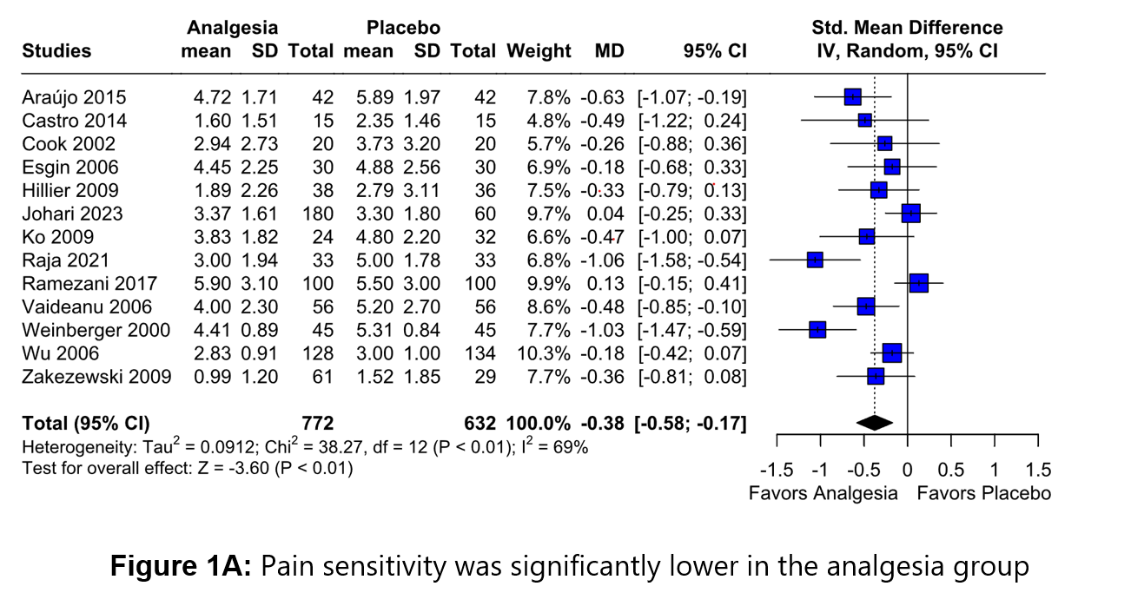
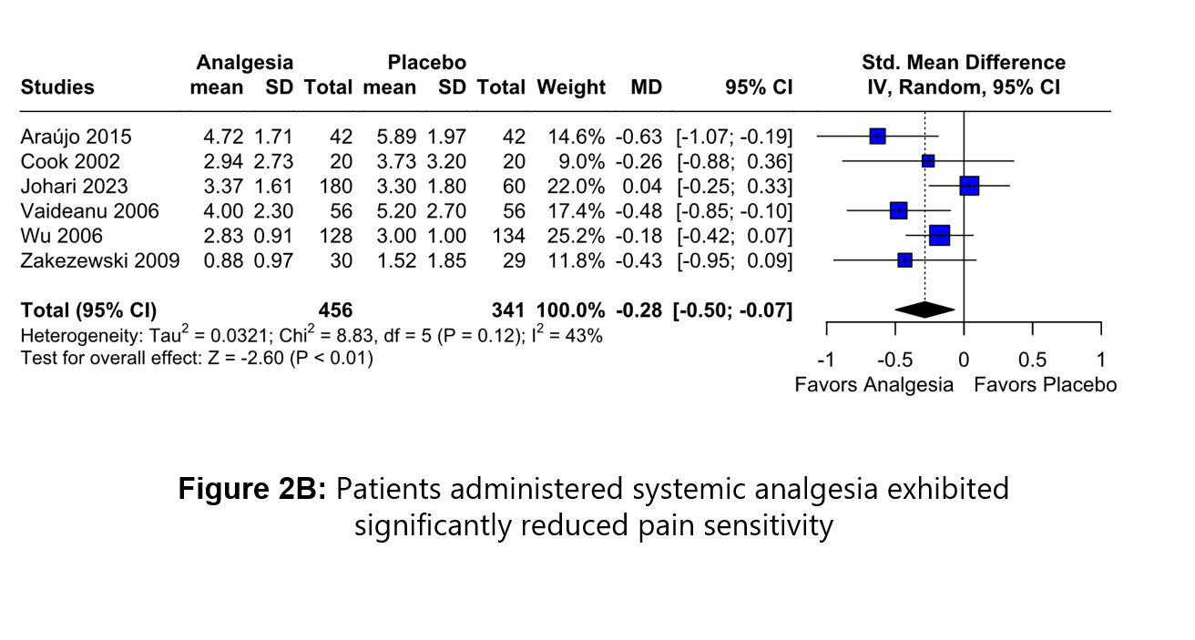
A COMPREHENSIVE META-ANALYSIS ON THE ROLE OF ANALGESICS AND ANTI-INFLAMMATORIES IN PAN-RETINAL PHOTOCOAGULATION
Mateus Arruda¹, Rian Vilar², João Lucas Moreira³, Larissa Barbosa⁴, Sara Hira⁵, Giulia Del Valle⁶
¹Instituto Penido Burnier, Campinas, São Paulo, Brazil – Department of Retina; ²Universidade de Fortaleza, Fortaleza, Ceará, Brazil; ³Universidade Estadual de Feira de Santana, Feira de Santana, Bahia, Brazil;
⁴Faculdade Santa Marcelina, São Paulo, São Paulo, Brazil; ⁵FMH College of Medicine & Dentistry, Lahore, Punjab, Pakistan; ⁶University of Iowa, Iowa City, Iowa, USA.
INTRODUCTION
Diabetic retinopathy (DR) is the leading cause of vision loss in the adult population.¹ Pan-retinal photocoagulation (PRP) has been shown to reduce the risk of vision loss in severe non-proliferative diabetic retinopathy (NPDR) and proliferative diabetic retinopathy (PDR) and is therefore the mainstay of treatment for these conditions^{2,3}. Patients may experience varying degrees of ocular discomfort or pain, based on the type of laser and the duration of the procedure, and this is a potential obstacle, making pain relief strategies necessary. The administration of anesthesia is an alternative for patients who are intolerant of treatment. Despite their effectiveness, these methods are invasive and can be accompanied by potential complications. Safer analgesic approaches have been suggested, such as oral, intramuscular, topical or inhalation methods.
INTRODUCTION
METHODS
We conducted a systematic review and meta-analysis according to PRISMA guidelines. The PubMed, Embase and Cochrane databases were searched for randomized controlled trials (RCTs) that enrolled patients undergoing PRP due to DR and compared analgesics or non-steroidal anti-inflammatory drugs (NSAID) to placebo. We prospectively registered on PROSPERO by the protocol number CRD42023488541.
Inclusion in this meta-analysis was restricted to studies that met all the following eligibility criteria: (1) randomized controlled trials (RCTs); (2) comparing analgesics or NSAIDs to placebo; (3) enrolling patients undergoing PRP; and (4) reporting the clinical outcome of interest visual analogue scale (VAS) for pain. There was no restriction on follow-up time.
As per Cochrane Collaboration's recommendations, we used a random-effects model with a restricted maximum-likelihood estimator to compare standardized mean differences (SMDs) with 95% confidence intervals (CIs) for continuous endpoints. We considered a P value of <0.05 as statistically significant. Cochrane's Q test and I2 statistics were used to assess heterogeneity. We regarded a P value of <0.10 and an I2 of >25% a statistically significant for heterogeneity when assessing subgroup interactions.
RESULTS
We included 13 RCTs, of which nine were crossover, comprising 1,404 eyes. A total of 772 (55%) received analgesia and 632 (45%) received placebo. Three studies had more than one intervention, with laser parameters consistently aligned with those derived from the Early Treatment Diabetic Retinopathy Study (ETDRS) across all studies. The administration of analgesia was associated with a significantly lower pain sensitivity compared to placebo (SMD -0.38; 95% CI -0.58, -0.17; P<0.01; I²=69%; Figure 1A).
In the comparison of NSAIDs alone to placebo, there was a statistically significant reduction in pain sensation in the intervention group (SMD -0.38; CI -0.62, -0.14; P<0.01; I²=74%).
Furthermore, a dedicated quantitative synthesis of studies examining systemically administered drugs demonstrated a statistically significant reduction in pain sensation (SMD -0.28; CI -0.50, -0.07; P<0.01; I²=43%: Figure 2B). Also, when exclusively considering eye drops administration, a statistically significance difference was observed between groups regarding pain sensation (SMD -0.46; CI -0.88, -0.05; P=0.03; I²=83%).
However, when performing the leave one out analysis reduction in heterogeneity seems to remain a high heterogeneity.
CONCLUSION
REFERENCES
The results of this systematic review and meta-analysis including over 1,000 patients demonstrated that the use of analgesia in PRP reduces pain sensitivity. Notably, the administration of systemic analgesics/NSAIDs prior to PRP significantly reduces procedural pain. Also happen during use of topical analgesics/NSAIDs, however, with high heterogeneity. Performing leave one out analysis the heterogeneity remains high. Hence, systemic approach might be preferred.

