Slide 1
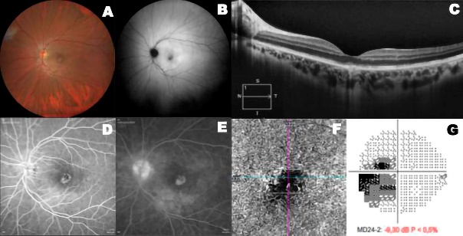
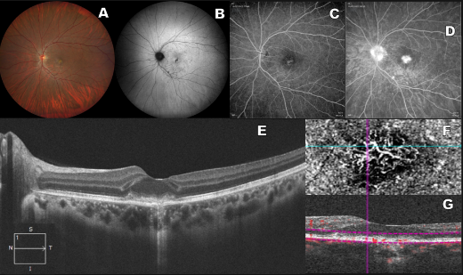
CHOROIDAL NEOVASCULARIZATION IN UNILATERAL ACUTE IDIOPATHIC MACULOPATHY ASSOCIATED WITH COXSACKIEVIRUS B2
Author and Co-authors: Roizenblatt A¹, Meirelles R¹, Gehlbach PL², Junior RB¹ ³, Roizenblatt M¹
1 Department of Ophthalmology, Universidade Federal de São Paulo, São Paulo, Brazil.
2 Department of Ophthalmology, the Wilmer Eye Institute at the Johns Hopkins University, Baltimore, MD, USA
3 Instituto Paulista de Estudos e Pesquisas em Oftalmologia (IPEPO), Universidade Federal de São Paulo, São Paulo, Brazil.
Purpose: To present a case of choroidal neovascularization in unilateral acute idiopathic maculopathy (UAIM) associated with coxsackievirus B2.
Introduction: We present a case of UAIM with coxsackie B2 positive serology, presenting choroidal neovascularization (CNV) as a complication. Follow-up multimodal retinal Imaging was performed to characterize the macular abnormalities further
Case Report: A 27-year-old woman complained of a sudden central visual field scotoma in her left eye two days before her presentation. The patient reported flu-like symptoms two weeks before her initial ophthalmic symptoms. Ophthalmologic examination and multimodal imaging were performed at initial presentation and at 2 months follow-up, when choroidal neovascularization was detected. The patient underwent an intravitreous Ranibizumab injection in the LE. After the injection, the OCT was repeated and there was partial decrement of the subretinal hyperreflective area and visual acuity improved to 20/30
Discussion: To the best of our knowledge, no previous reports were found linking coxsackie B2 infection with UAIM and CNV. The present case report demonstrates the importance of serial multimodal imaging to guarantee accurate diagnosis and effective therapy for patients with UAIM secondary to coxsackievirus infection, regardless of the virus variant involved.
Figure 1.
Figure 2.

