Slide 1
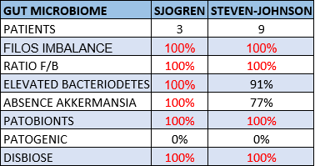
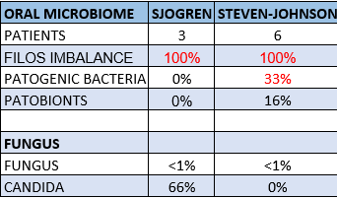
Ocular, oral and gut microbiomes characterization of patients with Stevens-Johnson Syndrome compared to Sjogren Syndrome and healthy patients
Authors: Luciana Frizon, Talita T Rocchetti, André Frizon, Rafael Alcântara, Ana Luiza Hoffling-Lima, José Álvaro Pereira Gomes
Ophthalmology Department - UNIFESP
INTRODUCTION
The Microbiome is defined as the collection of microorganisms in a particular environment.
Dysbiotic microbiome appears to be intimately connected to some diseases.
The gut-eye axis is especially relevant to ophthalmology in Sjogren’s Syndrome (SS).
In Stevens-JonhsonSyndrome (SJS): there is a chronic inflammatory ocular process, and a genetic alteration in Toll receptors that react excessively to some microorganisms. In ocular surface there is increased pathogenic bacteria.
PURPOSE
This study aims to characterize by the Next-Generation Sequencing method (NGS) the microbiome of the ocular surface, oral, and gut in patients with Stevens-Jonhson Syndrome (SJS) and compare to microbiome of individuals with primary Sjogrens’s Syndrome (SS) and healthy patients.
METHODS
Specimes were collect with sterile swabs from inferior conjunctiva of right eye and oral mucosa, and fecal samples from 10 patients with SJS, 10 patients with primary SS and 10 healthy controls.
All microbiomes were assessed using Next-Generation sequence of 16S rRNA V3-V4 (bacteria) and ITS region (fungi) – DNA extraction using ZymoBIOMICS DNA Kit – Qiagen library kit – MiSeq Illumina platform – Silva Database.
The severity of dry eye were graded (TBUT, NEI score, Schirmer 1).
Inclusion criteria: More than 18 years old, chronic SJS and SS, not using systemic antibiotics for 3 months and ocular and oral antibiotics and prebiotics / probiotics for 30 days.
RESULTS
Mean age: SJS 37.44 years, SS 56.33 years, controls 39.33 years.
Gender: SJS and controls 66.6% female, SS 100% female.
100% of SJS and SS had gut dysbiosis.
SJS and SS group had severe dry eye level.
At this moment, ocular microbiome and control group is in bioinformatics analyses.
Table 1: Results of gut microbiome
Table 2: Results of oral microbiome
CONCLUSION
We believe this valuable study will provide information that will be important to guide treatment with prebiotics and probiotics to restore the gut ecosystem in Stevens-Jonhson Syndrome.
REFERENCES
1-de Paiva CS, Jones DB, Stern ME, Bian F, Moore QL, Corbiere S, et al. Altered Mucosal Microbiome oral microbiota composition in primary Sjögren’s Syndrome . Sci Rep. 2016 Apr 18;6:23561.
2- Trujillo-Vargas CM, Schaefer L, Alam J, Pflugfelder SC, Britton RA, de Paiva CS. The gut-eye-lacrimal gland-microbiome axis in Sjögren Syndrome. Ocul Surf. 2020 Apr;18(2):335-344.
3- Moon J, Choi SH, Yoon CH, Kim MK. Gut dysbiosis is prevailing in Sjögren's syndrome and is related to dry eye severity. PLoS One. 2020 Feb 14;15(2):e0229029.
4- Kim YC, Ham B, Kang KD, Yun JM, Kwon MJ, Kim HS, et al. Bacterial distribution on the ocular surface of patients with primary Sjögren's syndrome. Sci Rep. 2022 Feb 2;12(1):1715.
5- Song H, Xiao K, Chen Z, Long Q. Analysis of Conjunctival Sac Microbiome in Dry Eye Patients With and Without Sjögren's Syndrome. Front Med (Lausanne). 2022 Mar 8;9:841112.
6- Wang Y, Wei J, Zhang W, Doherty M, Zhang Y, Xie H, et al. Gut dysbiosis in rheumatic diseases: A systematic review and meta-analysis of 92 observational studies. EBioMedicine. 2022 Jun;80:104055.

