Slide 1
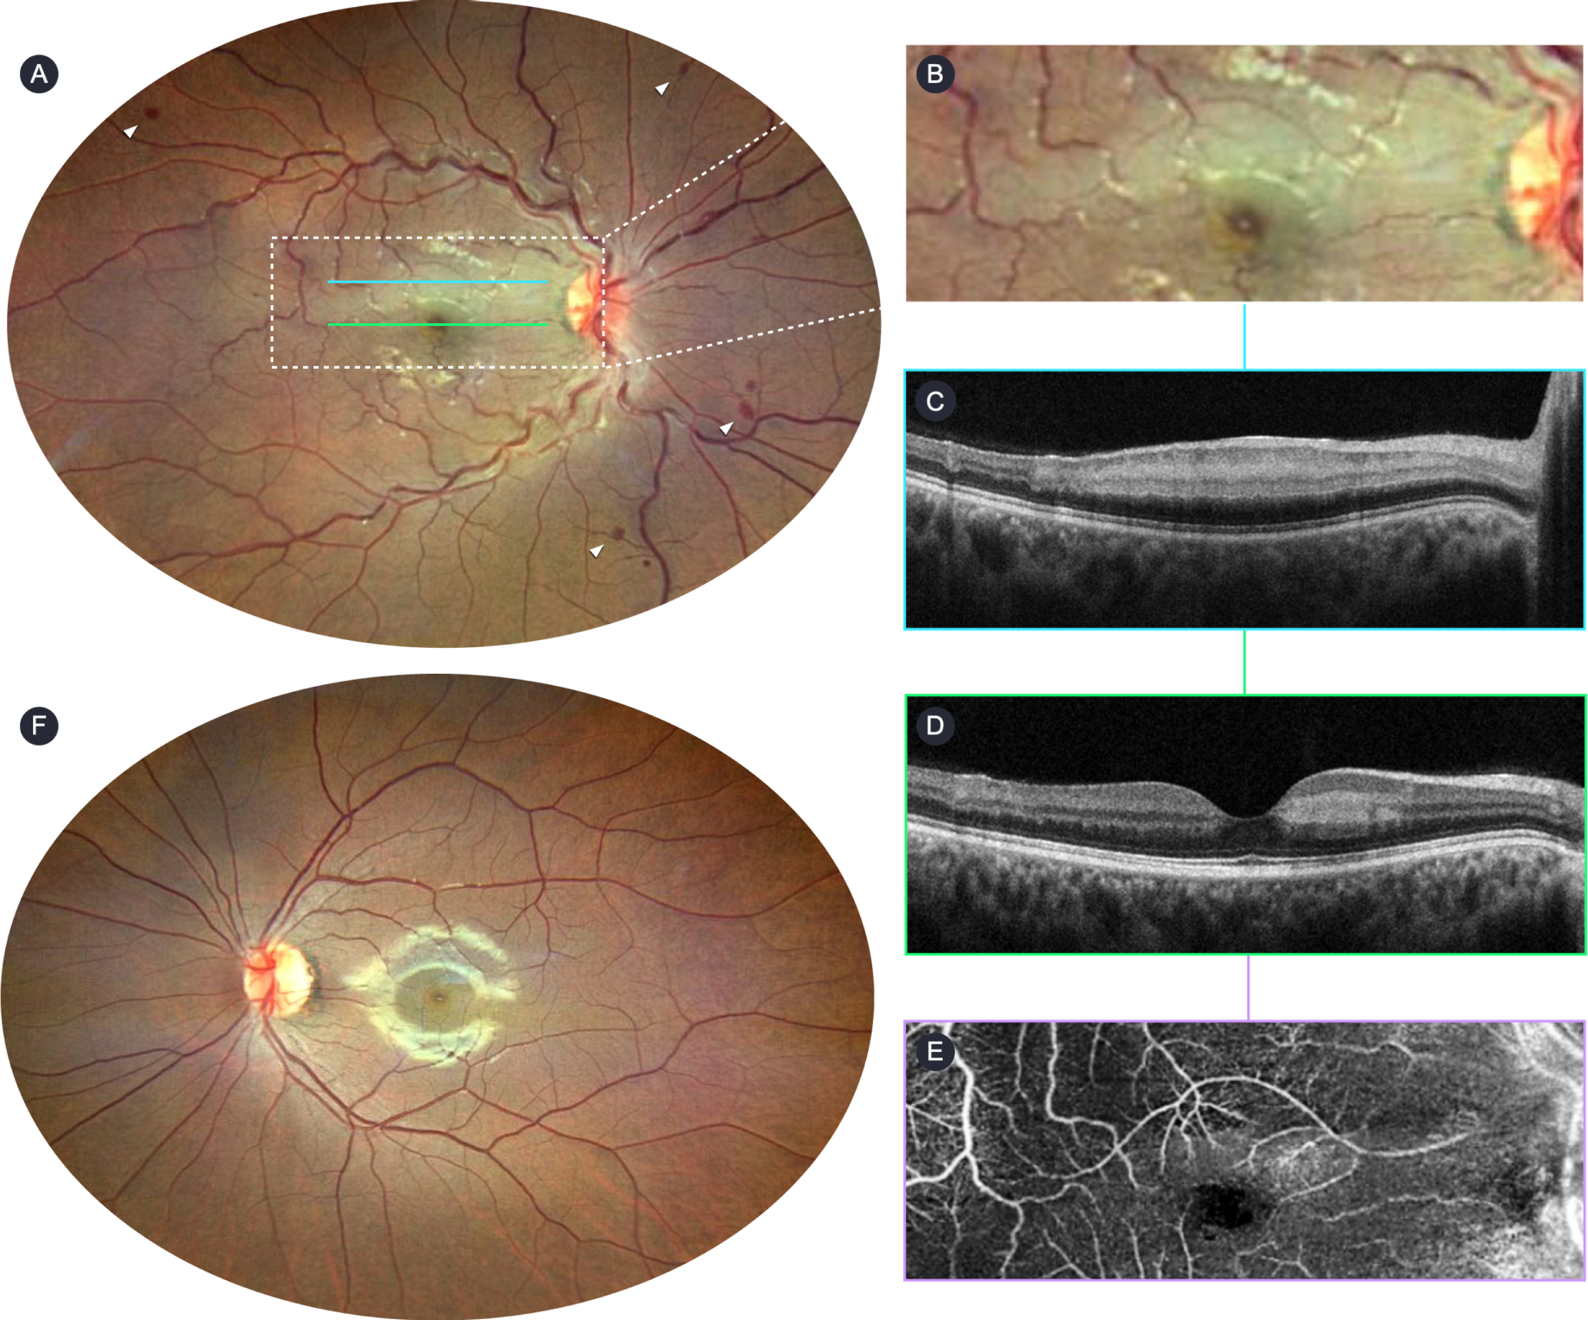
Retinal Central Vein and Cilioretinal Artery Occlusion Associated with High-Dose Caffeine Intake: A Case Report
Guilherme C Teixeira¹, Lucas A Linhares¹, Victor A Araújo¹, Pedro G Moreira¹, Bruno FA Ferreira¹,²
¹Hospital Geral de Fortaleza, Ceará, Brasil | ²Hospital das Clinicas FMUSP, Faculdade de Medicina, Universidade de Sao Paulo, Sao Paulo, Brasil.
INTRODUCTION
The cilioretinal artery experiences lower perfusion pressure compared to the central retinal artery, resulting in its relative occlusion.¹ Cilioretinal artery occlusion (CLRAO) accounts for 5-7% of retinal artery occlusions and is often associated with central retinal vein occlusion (CRVO) or anterior ischemic optic neuropathy.²⁻⁴ A significant vasoconstrictive response of retinal vessels has been observed after ingesting high doses of caffeine in healthy young individuals,⁵ as exemplified by this report of a young patient who developed CLRAO associated with CRVO.
METHODS
Observational study of a case of retinal central vein and cilioretinal artery occlusion associated with high-dose caffeine intake.
CASE REPORT
A 20-year-old woman, without comorbidities or ophthalmological history, was admitted with a sudden decrease in visual acuity in the right eye (OD) for one day. She denied the use of oral contraceptives and had no prior abortions. Her best-corrected visual acuity (BCVA) was 20/200 in the OD and 20/20 in the left eye (OS). Pupillary reflexes were normal and biomicroscopy revealed no relevant findings. Fundus photograph (Fig. 1B) indicated a perfused optic disc, diffuse venous tortuosity, and dot-blot hemorrhages in all four quadrants of the retina in the OD (white arrowhead), with the presence of cilioretinal artery (CLRA) exhibiting sheathing and perivascular retinal pallor. Macular optical coherence tomography (OCT) showed an increased retinal thickness in the superior parafoveal region (Fig. 1C) and a hyper-reflectivity band in the inner plexiform, inner nuclear and outer plexiform layers (Fig. 1D), consistent with acute paracentral middle maculopathy (PAMM). This findings were corroborated by evidence of macular ischemia on OCT angiography (Fig. 1E). No abnormalities was observed in the OS (Fig. 1F).Thus, the diagnosis of unilateral CLRAO associated with non-ischemic CRVO was made, prompting an extensive multidisciplinary etiological investigation.
Laboratory tests were conducted, revealing no nutritional, rheumatological, hematological, or infectious causes for the condition. Additionally, carotid Doppler ultrasound and neuroimaging were performed, yielding no relevant findings. In the absence of alterations indicating an etiology, an in-depth medical history was pursued, during which the patient reported ingesting high doses of caffeine (800 mg/day) through capsules on the day of symptom presentation. Subsequently, the patient was advised to discontinue caffeine supplementation and to initiate the use of brimonidine tartrate eye drops t.i.d. Full BCVA recovery was achieved over the course of 2 months.
CONCLUSION
High-dose caffeine intake may be associated with retinal arterial occlusion. Therefore, in young individuals without apparent comorbidities, lifestyle factors need to be considered in the etiological assessment of retinal vascular occlusions.
REFERENCES
Terai N, Spoerl E, Pillunat LE, Stodtmeister R. The effect of caffeine on retinal vessel diameter in young healthy subjects. Acta Ophthalmol. 2012;90(7):524–8.
Schatz H, Fong AC, McDonald HR, Johnson RN, Joffe L, Wilkinson CP, Laey JJ, Yannuzzi LA et al. Cilioretinal artery occlusion in young adults with central retinal vein occlusion. Ophthalmology. 1991;98(5):594–601.
Brown GC, Shields JA. Cilioretinal arteries and retinal arterial occlusion. Arch Ophthalmol. 1979;97:84–92.
Hayreh SS. Pathogenesis of occlusion of the central retinal vessels. Am J Ophthalmol. 1971;72:998–1011.
Brown GC, Moffat K, Cruess A, Magargal LE, Goldberg RE. Cilioretinal artery obstruction. Retina. 1983;3(3):182-7.

