Slide 1
Keratoglobus: a rare case of corneal ectasia
VANESSA DIB SALGE
HOSPITAL EVANGÉLICO DE BELO HORIZONTE
Rare corneal ectasia related to defects in collagen synthesis and thinning, ruptures in Bowman layer.

Slide 2
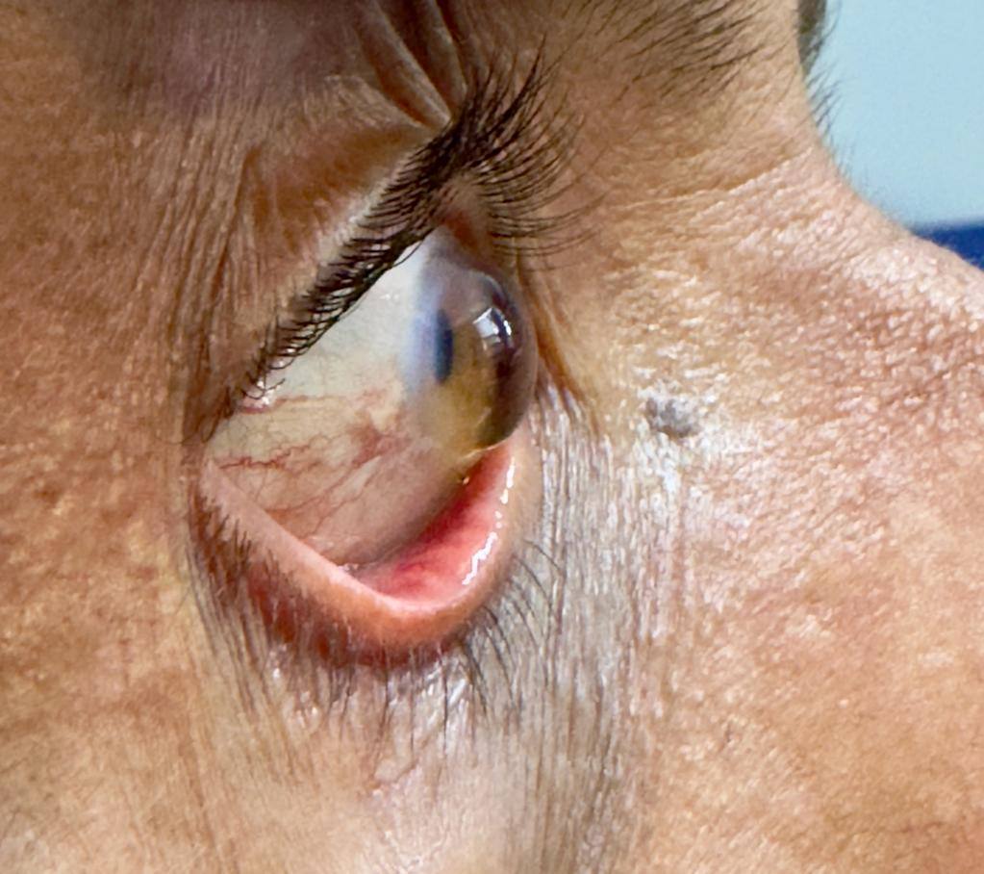
Centro Oftalmológico – Hospital Evangélico de Belo Horizonte

