Slide 1
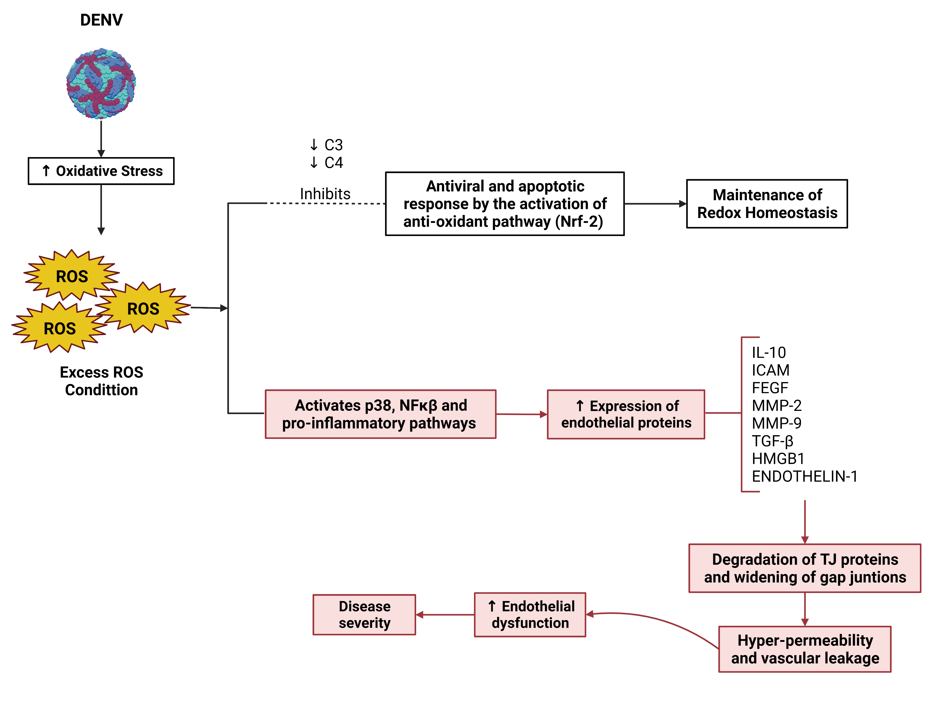
The retinal vasculopathy in dengue fever:
a reactive oxygen species (ROS) modulation.
Cruz, MFS^{1,2}; Lucena-Neto, FD¹; Cruz, SFS^{1,3}; Vieira-Junior, AS¹;
Falcão, LFM^{1,4}; Quaresma, JAS^{1,4}.
1 - Universidade do Estado do Pará (UEPA); 2 - Universidade Federal de São Paulo (UNIFESP); 3 - Santa Casa de Misericórdia de São Paulo (FSCMSP); 4 - Universidade de São Paulo (USP)
INTRODUTION
FIGURE
Dengue fever, the most prevalent arbovirus disease, annually impacts an estimated 390 million individuals. The Dengue virus (DENV) belongs to the Flaviviridae family and comprises four distinct serotypes. Dengue hemorrhagic fever represents the most lethal manifestation of dengue infection, characterized by thrombocytopenia, hypotension, and the potential for multi-system organ failure.
In a retrospective analysis by Teoh et al. (2006), the study documented an incidence of 23.1%, 20%, and 10.8% for retinal vasculitis, extensive pan-retinal vasculitis associated with exudative retinal detachment, and posterior vitreous cells, respectively, in a cohort involving 65 eyes (50 patients). These manifestations stem from partial C4 complement deficiency.
The excessive production of reactive oxygen species (ROS) disrupts the lysosomal membrane, leading to the release of hydrolases, which triggers autophagy in phagocytic cells and subsequent cell death, culminating in a robust cytokine storm and organ failure. The vascular endothelium emerges as the primary target of oxidants released by activated blood cells at the site of injury or inflammation.
MATERIAL E METHODS
We conducted a semi-systematic narrative review. The principal databases employed to gather pertinent medical literature featured in this review were PubMed, ScienceDirect, and Cochrane. The search terms utilized, both independently and in conjunction, encompassed: "Dengue eye disease," "Dengue ocular," "Dengue ocular manifestation," "DENV pathophysiology," "dengue uveitis," and "dengue eye retinitis."
CONCLUSION
Excessive production of reactive oxygen species (ROS) disrupts the lysosomal membrane and induces the release of hydrolases, resulting in autophagy in phagocytic cells and subsequent cell death, followed by a strong cytokine storm and organ failure.
Additionally, exposure of the vascular endothelium to various blood-borne pathogens or agents can prompt activated neutrophils to release a substantial amount of ROS into the circulation via membrane-bound NADPH oxidase during the neutrophil respiratory burst. This phenomenon leads to host tissue injury and endothelial barrier dysfunction.
Retinal vasculopathy in Dengue Fever can manifest in various forms and has been associated with immune-mediated mechanisms, such as immune complex deposition in vessels and capillary occlusions.
DISCUSSION
Retinal vasculopathy in Dengue Fever can manifest in various forms, ranging from retinal hemorrhages to branch retinal artery occlusions, and has been linked to immune-mediated mechanisms, such as immune complex deposition in vessels and capillary occlusions. Vasculopathy initiates endothelial activation and apoptosis in the initial or activation phase, as well as dysfunction of endothelial cells in the critical or damage phase.
Evidence suggests that reactive oxygen species (ROS)-mediated modulation of signal transduction pathways (activation of the transcription factors AP-1 and NFκB, as well as the p38-MAPK pathway) in endothelial cells serves as a pivotal signaling mechanism for endothelial activation. Additionally, oxidative stress-induced activation of endothelial cells and platelets is presumed to contribute to disease severity during viral infection.
REFERENCES
Wang H, Liu M. Complement C4, Infections, and Autoimmune Diseases. Front Immunol. 2021;12:694928. doi:10.3389/fimmu.2021.694928.
Zhang J, Wang X, Vikash V, et al. ROS and ROS-Mediated Cellular Signaling. Oxid Med Cell Longev. 2016;2016:4350965. doi:10.1155/2016/4350965.

