Slide 1
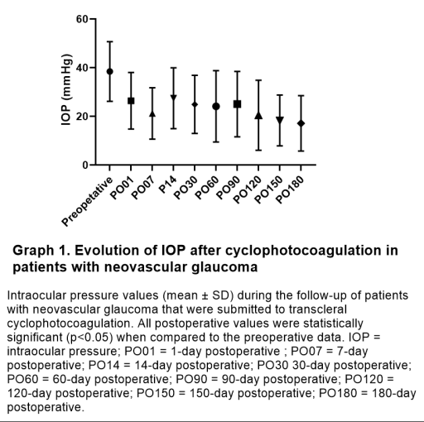
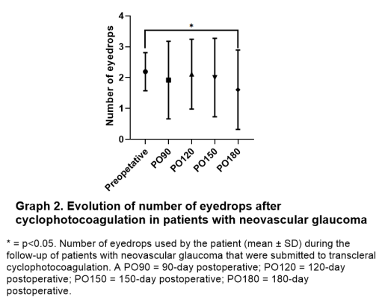
Retrospective Evaluation of Cyclophotocoagulation Procedure in Neovascular Glaucoma
Barbosa JP¹; Harckbart FG¹; Gusmão PF¹; Melo LAS¹.
¹Universidade Federal de São Paulo, São Paulo – SP.
INTRODUCTION AND OBJECTIVE
As a limitation of this study, the data acquired was based on medical records, thus being susceptible to variability in the fulfillment of the information. Beyond that, more than half of the patients were using acetazolamide before cyclophotocoagulation, while no patient was using the medication after six months. This could underestimate the efficacy of the procedure. Furthermore, 20 (31.74%) of the 63 patients needed more than one cyclophotocoagulation for intraocular pressure reduction, so the evaluation of the efficacy of each isolated procedure was not precisely analyzed.
The purpose of this study was to evaluate the efficacy and safety of cyclophotocoagulation in patients with neovascular glaucoma.
MATERIAL AND METHODS
GRAPHS
Retrospective analysis of data from the electronic medical record of patients who were treated with cyclophotocoagulation for neovascular glaucoma during the year 2022 with a six-month follow-up was performed. Data regarding the etiology of neovascular glaucoma, the previous use of acetazolamide, the number of ocular hypotensors and intraocular pressure before and after the procedure were assessed. The Graph Pad Prism Version 8.0.1 was used for statistical analysis.
RESULTS
A total of 66 eyes of 64 patients who were treated with cyclophotocoagulation for neovascular glaucoma during 2022 were included in this study. There were 35 (53.05%) cases of proliferative diabetic retinopathy and 26 (39.39%) cases of central retinal vein occlusion. During six months, three (4.54%) eyes lost post-operative follow-up. Among the cases that completed the follow-up, the mean initial intraocular pressure was 38.46 (± 12.28) mmHg and the initial number of ocular hypotensors was 2.19 (±0.61). A total of 48 (76.19%) patients were using acetazolamide before cyclophotocoagulation. The mean intraocular pressure was 24.91 (± 11.94) mmHg at the thirtieth postoperative day (p < 0.0001) and 17.14 (± 11.44) mmHg after six months of the surgery (p < 0.0001) (Graph 1). Cyclophotocoagulation was indicated again in 20 (31.74%) eyes. After six months of follow-up, the number of ocular hypotensors was 1.60 (± 1.28) (p = 0.0144) (Graph 2). Regarding safety, seven eyes had an initial visual acuity of no light perception. Among the remaining eyes, 21 (37.53%) of them evolved with no light perception visual acuity. No eye evolved to phthisis bulbi.
DISCUSSION
In our analysis, the use of cyclophotocoagulation was associated with a significant reduction in intraocular pressure. A study compared the use of standard and slow cooking cyclophotocoagulation in treating ocular pain in neovascular glaucoma, pointing to mean intraocular pressure reduction in the first, 30th, and 90th postoperative days, although without statistical significance. Our data pointed out that more than one-third of the eyes that had visual acuity of at least light perception evolved to a visual status of no light perception, which could be explained by the severity of the disease, which leads to poor visual prognosis, especially when diagnosed in advanced stages. It is important to have an adequate follow-up of the conditions that are risk factors for neovascular glaucoma, so early treatment can be a reality.
CONCLUSION
Although transcleral cyclophotocoagulation is a well-known option for treating advanced glaucoma, its efficacy was insufficient in several eyes in our study, leading to procedure repetition. Beyond that, many eyes evolved to no light perception visual acuity, which could have been influenced by the initial severity of the neovascular glaucoma.
REFERENCES
Menezes, L. M., Souza, M. C. C., Ciarlini, L. R., Veríssimo, C. R., & Matos, A. G. (2020). Transescleral cyclophotocoagulation treatment for painful eye with glaucoma neovascular. Rev Bras Oftalmol., 79(1), 38-41.
Shazly, T. A., & Latina, M. A. (2009). Neovascular glaucoma: etiology, diagnosis and prognosis. Seminars in ophthalmology, 24(2), 113–121.
Dumbrăveanu, L., Cușnir, V., & Bobescu, D. (2021). A review of neovascular glaucoma. Etiopathogenesis and treatment. Romanian journal of ophthalmology, 65(4), 315–329.

