Slide 1
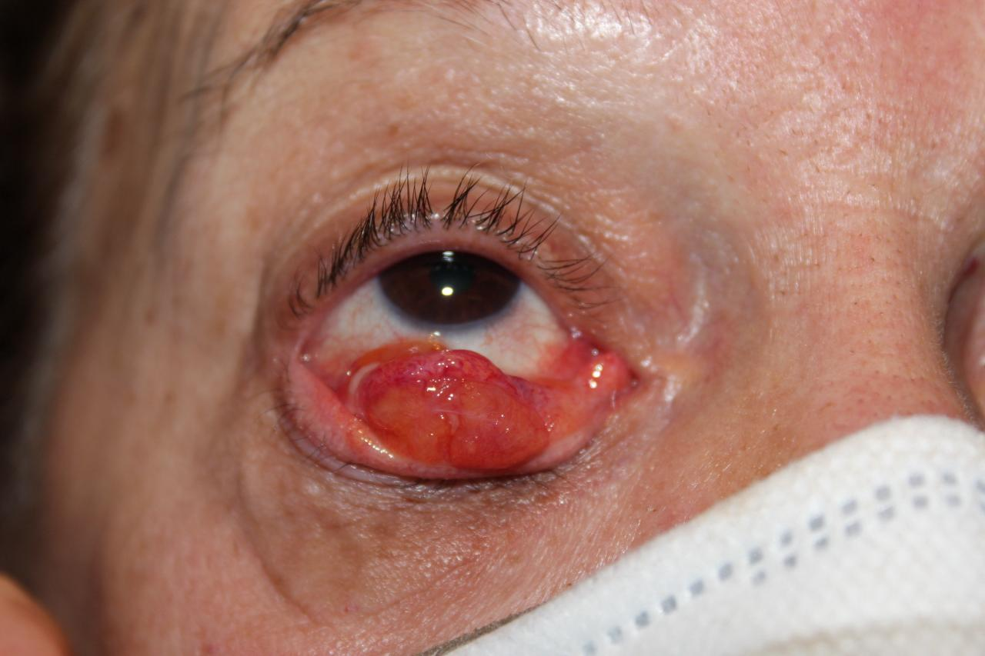
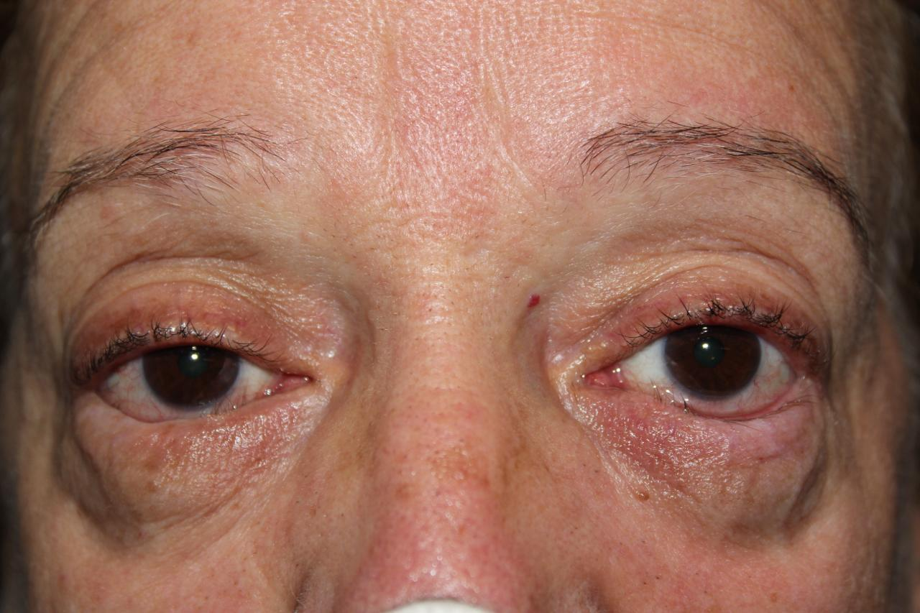
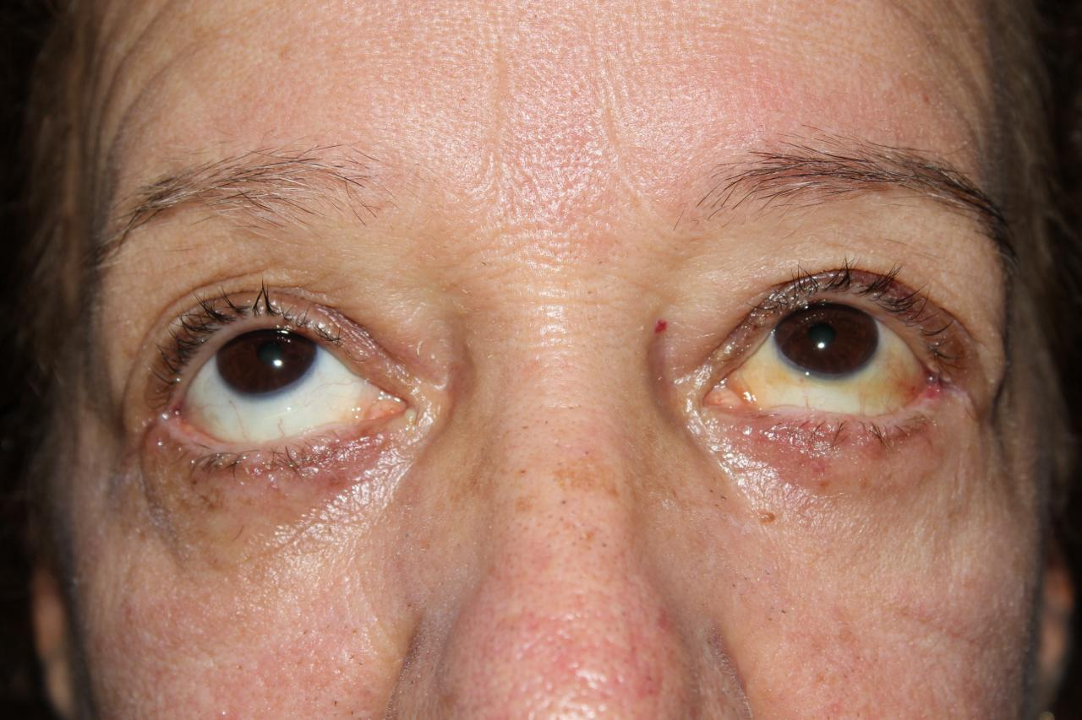
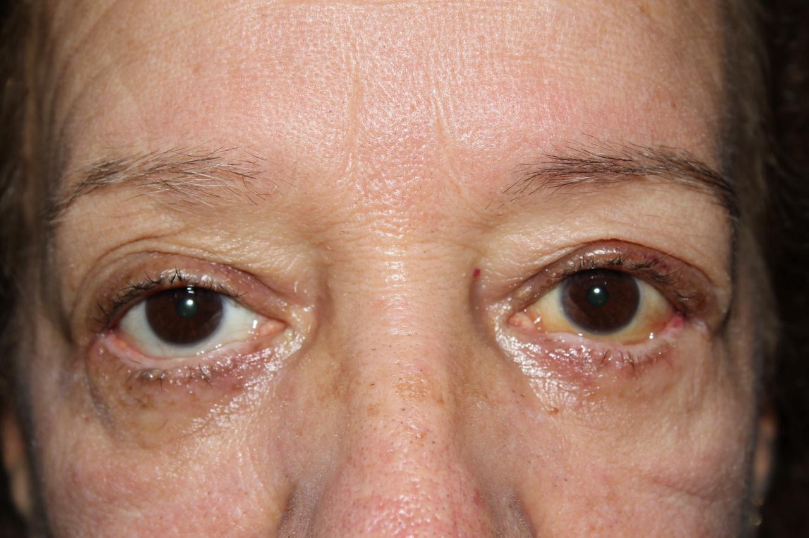
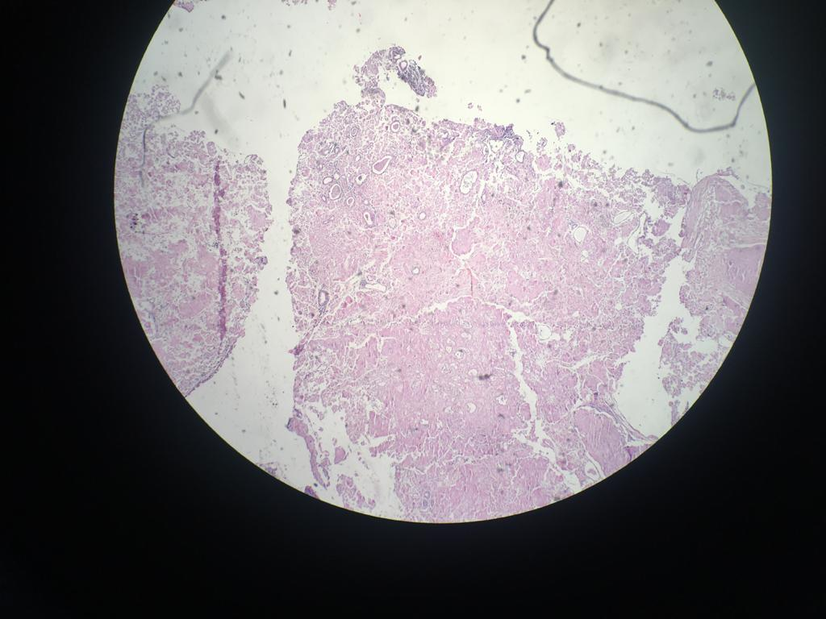
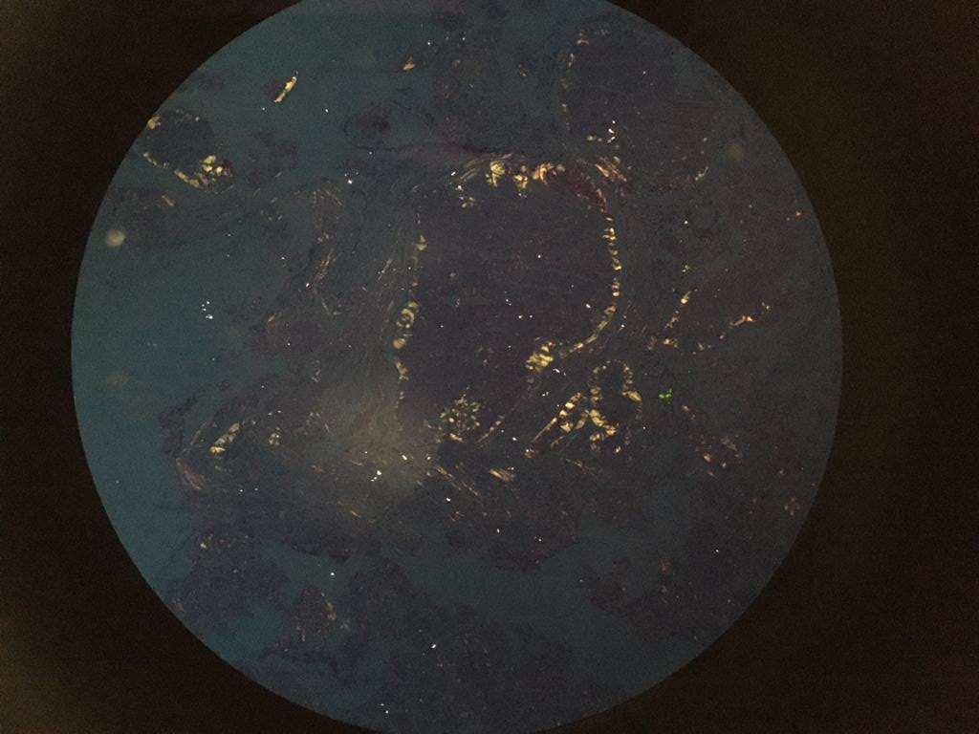
CONJUNCTIVAL AND PALPEBRAL AMYLOIDOSIS CAUSING BILATERAL ENTROPION: CASE REPORT
Guilherme Rufino Marques Pellegrin¹, Cristiana de Moraes Ramalho², Theo Ramalho Morais³, Nicole Bragantini Larivoir⁴, Maria Eduarda Corradi Ferreira⁵
1) Faculdade de Ciências Médicas e da Saúde de Juiz de Fora (FCMS-JF); 2) Oftalmo Centro de Oftalmologia, Juiz de Fora ; 3) Centro de Estudos e Pesquisas Oculistas Associados (CEPOA); 4) Hospital Universitário da UFJF (HU-UFJF); 5)Universidade Federal de Juiz de Fora (UFJF)
Introduction
Amyloidosis is a group of diseases where amyloid material is deposited in tissues. It can be classified as systemic or restricted to one organ, and subdivided into primary or secondary to chronic inflammatory disease. Primary conjunctival amyloidosis is a rare disease, typically unilateral, which clinically manifests as a pink or yellowish tumor, of variable size, painless, which can extend to the conjunctival sac, thereby altering the eyelid positioning. This case report describes a patient with a nodular lesion of the conjunctiva and bilateral lower eyelid that progressed to lower eyelid entropion and keratitis, whose surgical treatment with anatomopathological study revealed the diagnosis of amyloidosis.
Methods
This is a retrospective, observational and descriptive study of a patient with conjunctive palpebral amyloidosis. Data were obtained through outpatient follow-up.
Results
Patient CDFR, female, 63 years old, reports hardening of the lower eyelid and continuous eye irritation with epiphora and red eye, which began 2 years ago and progressively worsens. The ophthalmological examination revealed bilateral lower eyelid entropion, thickening of the lower eyelid and the presence of a hard, yellowish pink lesion with an irregular surface, which extended from the tarsal conjunctiva to the lower conjunctival fornix. Visual acuity with 20/20 correction in both eyes. Clear cornea with inferior superficial keratitis due to entropion, lens with mild sclerosis, formed anterior chamber and photo-reactive pupil. Normal fundoscopy in both eyes. Surgery was performed to resect the conjunctival lesions and correct the entropion with refixation of the lower eyelid retractor elements, creation of a tarsal strip with improvement of the horizontal eyelid tension and mini lower blepharoplasty. It progressed with improvement in corneal irritation symptoms, correction of entropion with good position of the eyelid margin. The biopsy confirmed the diagnosis of amyloidosis, through Congo red staining. Despite the impossibility of resection of all conjunctival lesions, the patient presented restoration of eyelid function and prevention of ocular damage.
Conclusion
Although ophthalmological involvement is uncommon in amyloidosis, it is necessary to pay attention to this diagnosis so that correct monitoring and investigation of possible systemic involvement can be carried out.
Key Words
Amyloidosis; Conjunctiva; Entropion.
1
2
3
4
5
6
Figures 1 and 2: before the surgery; 3 and 4: after surgery; 5 and 6: anatomopathological study
References
1) Al Nuaimi D, Bhatt PR, Steeples L, Irion L, Bonshek R, Leatherbarrow B. Amyloidosis of the orbit and adnexae. Orbit 2012; 31(5):287–298.
2) Colucci G, Alberio L, Demarmels Biasiutti F, Lämmle B. Bilateral periorbital ecchymoses: an often missed sign of amyloid purpura. Hamostaseologie. 2014; 34:249-52.
3) Gillmore JD, Wechalekar A, Bird J, Cavenagh J, Hawkins S, Kazmi M, et al. Guidelines on the diagnosis and investigation of AL amyloidosis. Br J Haematol. 2015; 168:207-18.
4) Grossniklaus HE, Green WR, Luckenbach M et al. Conjunctival lesions in adults. A clinical and histopathologic review. Cornea 1987; 6:78-116.
5) Kazmi M. AL amyloidosis. Medicine. 2013; 41:299-301.
6) Lee HM, Naor J, DeAngelis D, Rootman DS. Primary localized conjunctival amyloidosis presenting with recurrence of subconjunctival hemorrhage. Am J Ophthalmol 2000; 129: 245-247.
7) Pinney JH, Hawkins PN. Amyloidosis. Ann Clin Biochem. 2012; 49:229-41.
8) Rosenblatt M, Spitz GF, Friedman AH, Kazam ES. Localized conjunctival amyloidose: case reports and review of literature. Ophthalmologica 1986; 192: 238-245.
9) Sipe JD, Benson MD, Buxbaum JN et al. Amyloid fibril proteins and amyloidosis: chemical identification and clinical classification. International Society of Amyloidosis. Amyloid 2016; 23(4):209-213.
10) Soares, E.J.C.; Medeiros, A.; França, V.; Andrade, J.S.; Lopes, G.A. - Amiloidose Primária Conjuntivopalpebral. Rev. Bras. Oftalmol., 47: 289, 1988.

