Slide 1
ANTERIOR CAPSULAR PHIMOSIS: A NATURAL PINHOLE
LISSA CARVALHO WERNEQUE
HOSPITAL EVANGÉLICO DE BELO HORIZONTE
Centripetal stenosis and capsulorex fibrosis after facectomy by remnant metaplastic epithelial cells

Slide 2
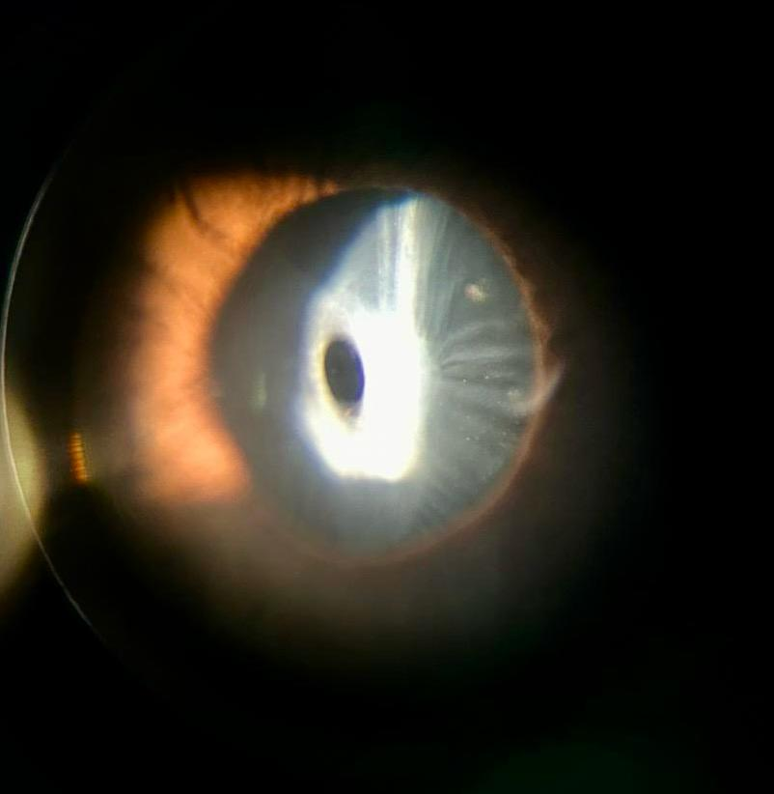
Centro Oftalmológico – Hospital Evangélico de Belo Horizonte

