Slide 1
LAURA GOLDFARB CYRINO UNIVERSIDADE DE SÃO PAULO; HC-FMUSP
Ocular Surface Squamous Neoplasia
Ocular surface squamous neoplasia (OSSN) encompasses a wide and varied spectrum of disease involving abnormal growth of dysplastic squamous epithelial cells on the surface of the eye. The patient was treated with two cycles of 5- fluorouracil (5-FU) with lesion regression.

Slide 2
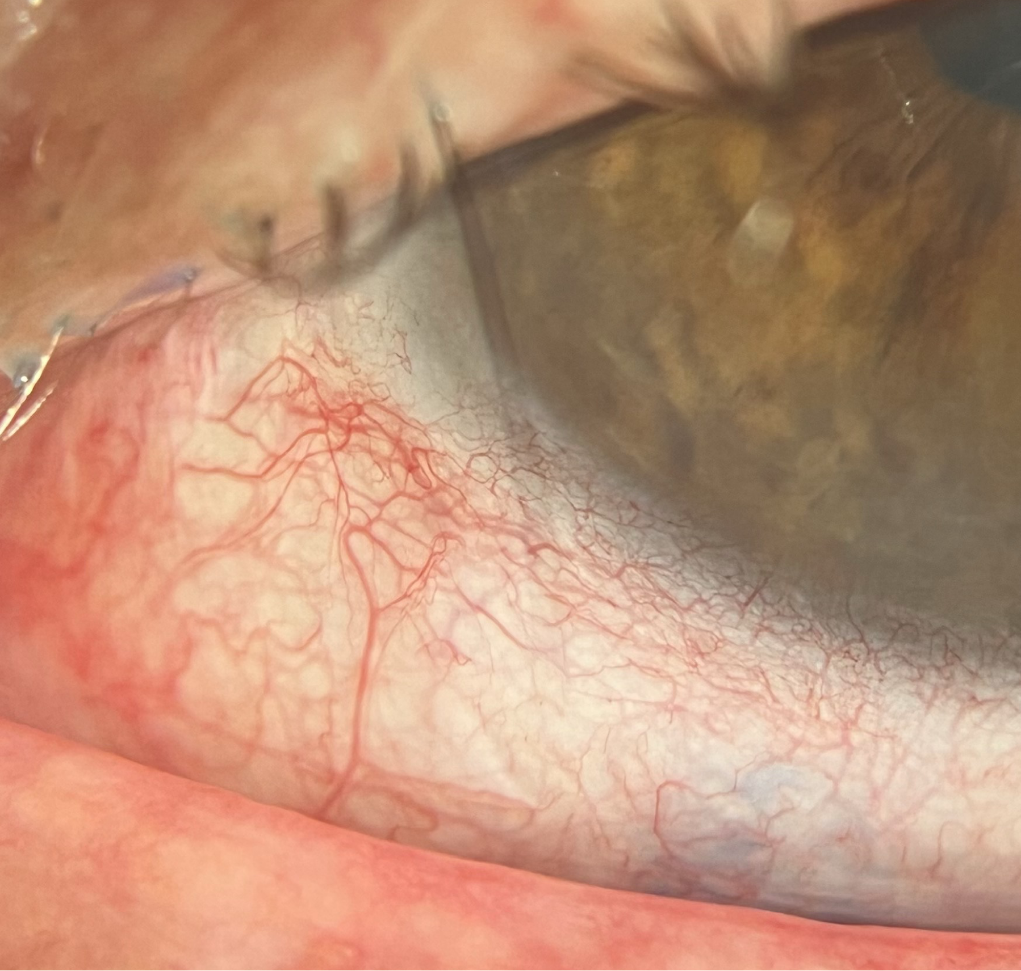
BEFORE TREATMENT
AFTER TREATMENT

